Slide 1
Confirming Galaxy-Galaxy Strong Lens Candidates with Euclid DR1
Juliana Karp

Slide 2
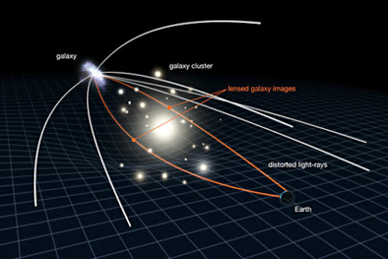
what is gravitational lensing?
light travels along geodesics the shortest path through spacetime
general relativity says that mass bends the fabric of spacetime
thus, the trajectory of light is bent by mass
Credit: NASA/ESA & L. Calçada

Slide 3
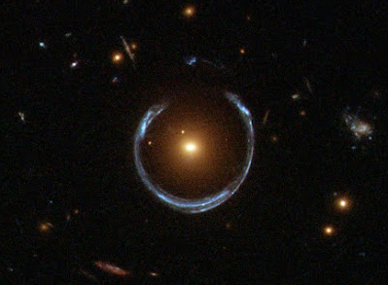
galaxy-galaxy strong lenses
the cosmic horseshoe, the closest strong galaxy-galaxy lens. a foreground luminous red galaxy (orange) acts as a lens to a background star-forming galaxy (blue).
angular einstein radius = 5”
z_{FG} = 0.444
z_{BG} = 2.379
Belokurov+2007
Credit: ESA/Hubble & NASA

Slide 4
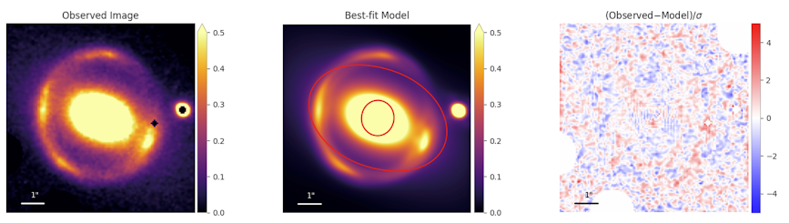
strong lensing is a powerful cosmological tool
detailed modeling of strong galaxy-galaxy lenses can reveal dark matter substructure at cosmological distances and provide direct measurements of dark matter halo density profiles, helping to constrain dark matter models.
Figure 8 from Huang+2025

Slide 5
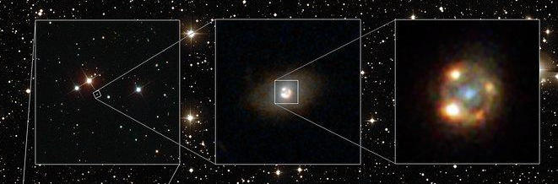
strong lensing is a powerful cosmological tool
time-delays from multiple images of the same lensed transient can be used to make novel independent measurements of the Hubble constant, a major cosmological tension today.
Credit: ESA/Hubble

Slide 6
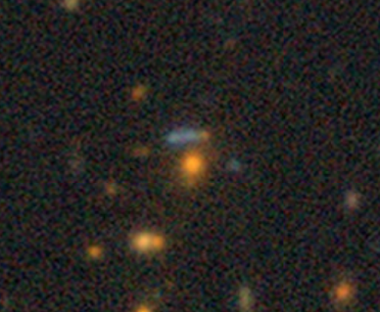
how do we find lenses?
traditionally, lenses are discovered in imaging surveys, then confirmed spectroscopically.
instead, we first select lens candidates spectroscopically, then seek to confirm them with high-resolution imaging.
Credit: Legacy Imaging Surveys

Slide 7
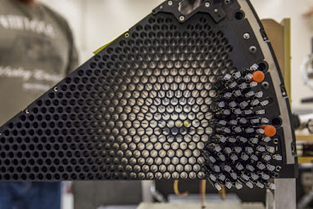
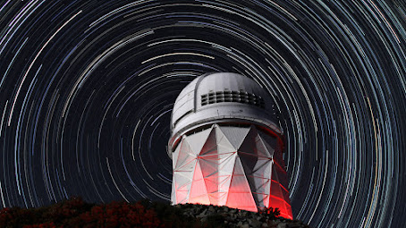
the Dark Energy Spectroscopic Instrument (DESI)
DESI observes 5,000 targets at once. over eight+ years, DESI is collect spectra of 30+ million galaxies. some of these will be lensing systems!
Credit: LBNL & DESI Collaboration
Credit: LBNL & DESI Collaboration

Slide 8
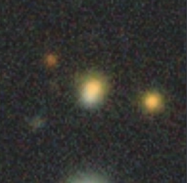

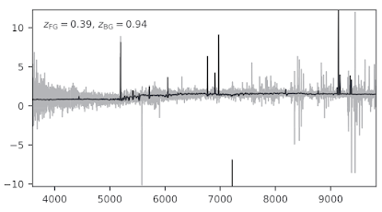
how does a spectroscopic lens search work?
Credit: Legacy Imaging Surveys

Slide 9
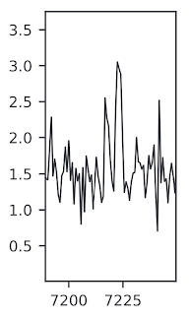
how does a spectroscopic lens search work?
[O II] λλ3727, redshifted to z = 0.94!

Slide 10
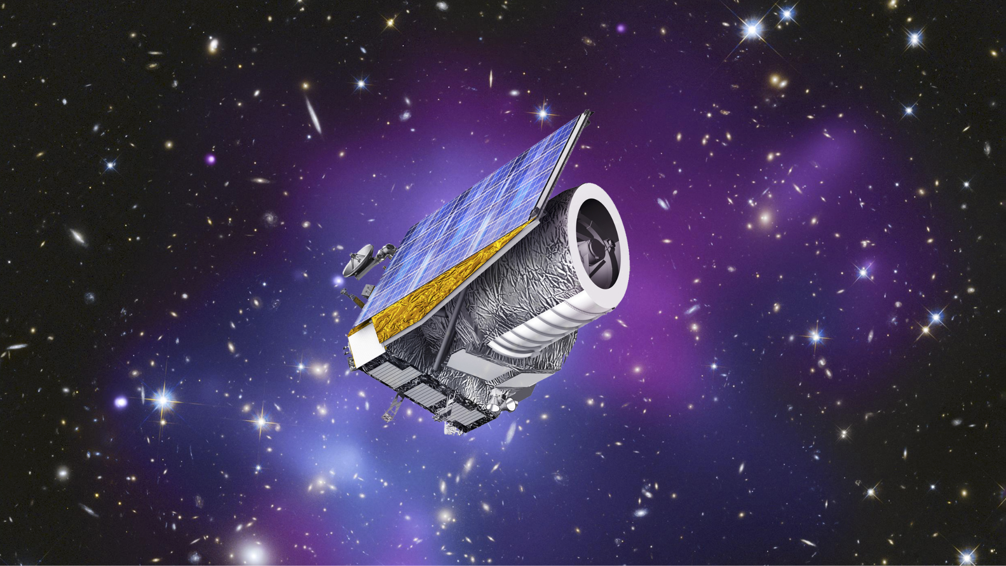
4 thousand lens candidates from DESI need confirmation with high-resolution imaging → Euclid telescope
Credit: ESA/C. Carreau

Slide 11
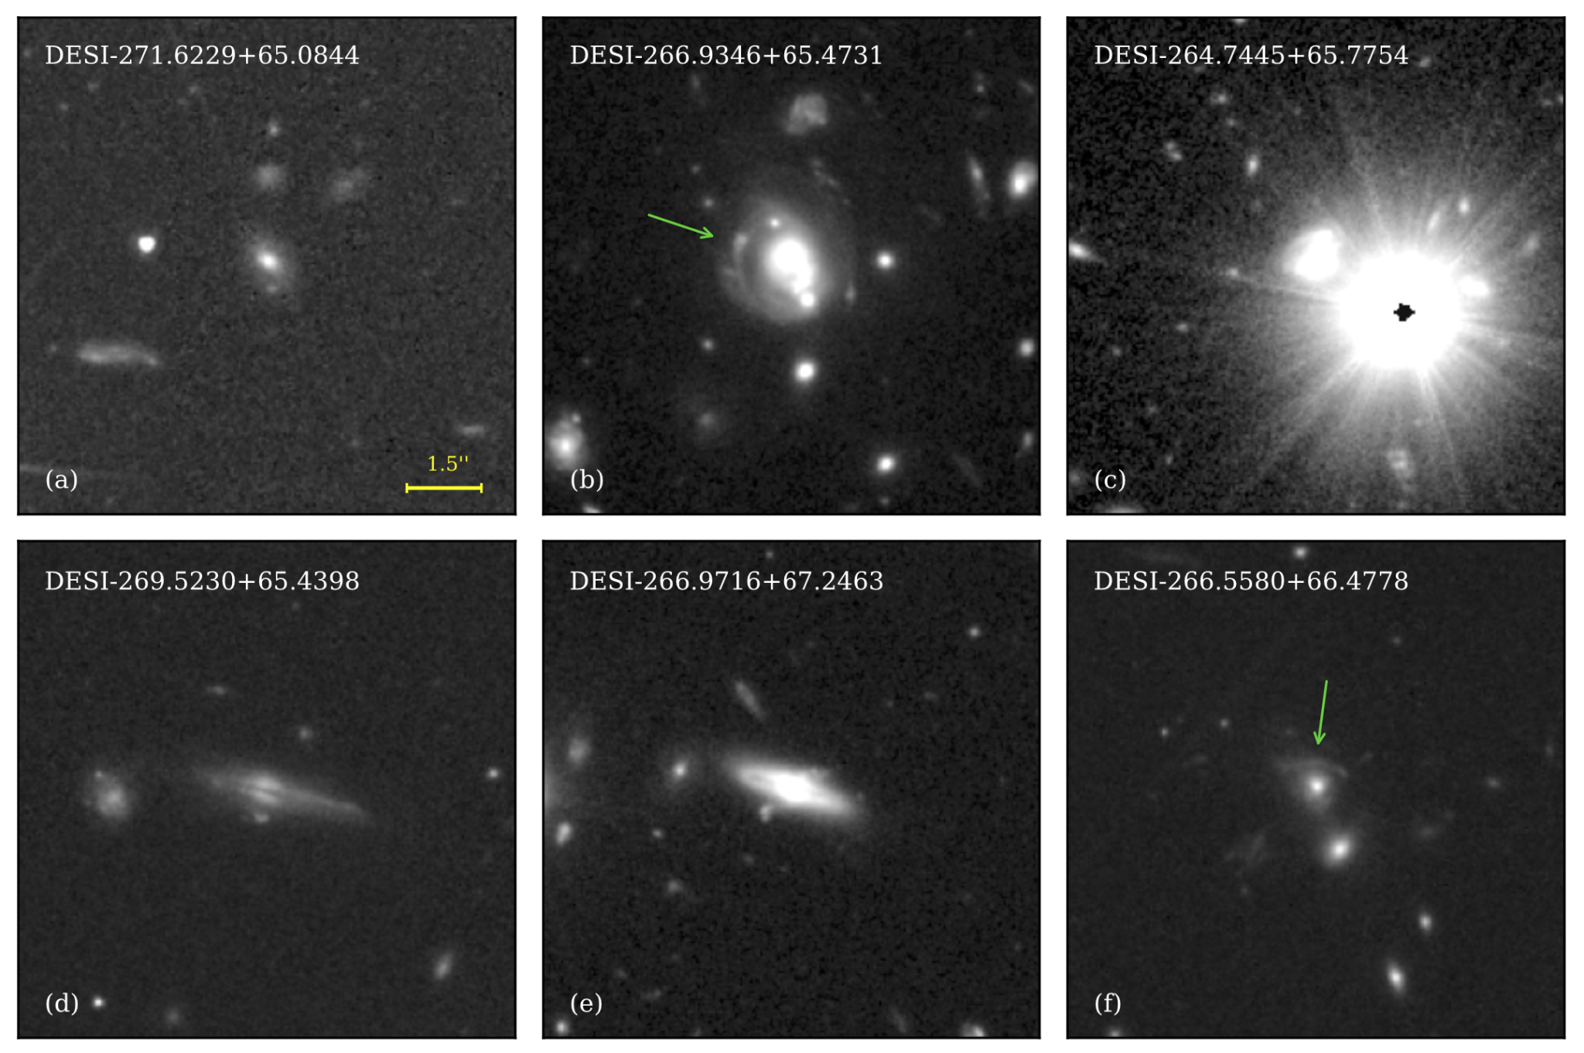
in this project, you will make images like these!
Euclid DR1 is coming out soon!
in an early Euclid data release, these 6 lens candidates were imaged. the two with green arrows are confirmed lenses!
you will make plots like these for all the lens candidates imaged in DR1, then search them for lensing features.
Figure 12 from Karp et al. (2026): 6 lens candidates imaged by Euclid in Q1

Slide 12
thank you! questions?

Slide 13
template white background

Slide 14
template blue background

